Slide 1
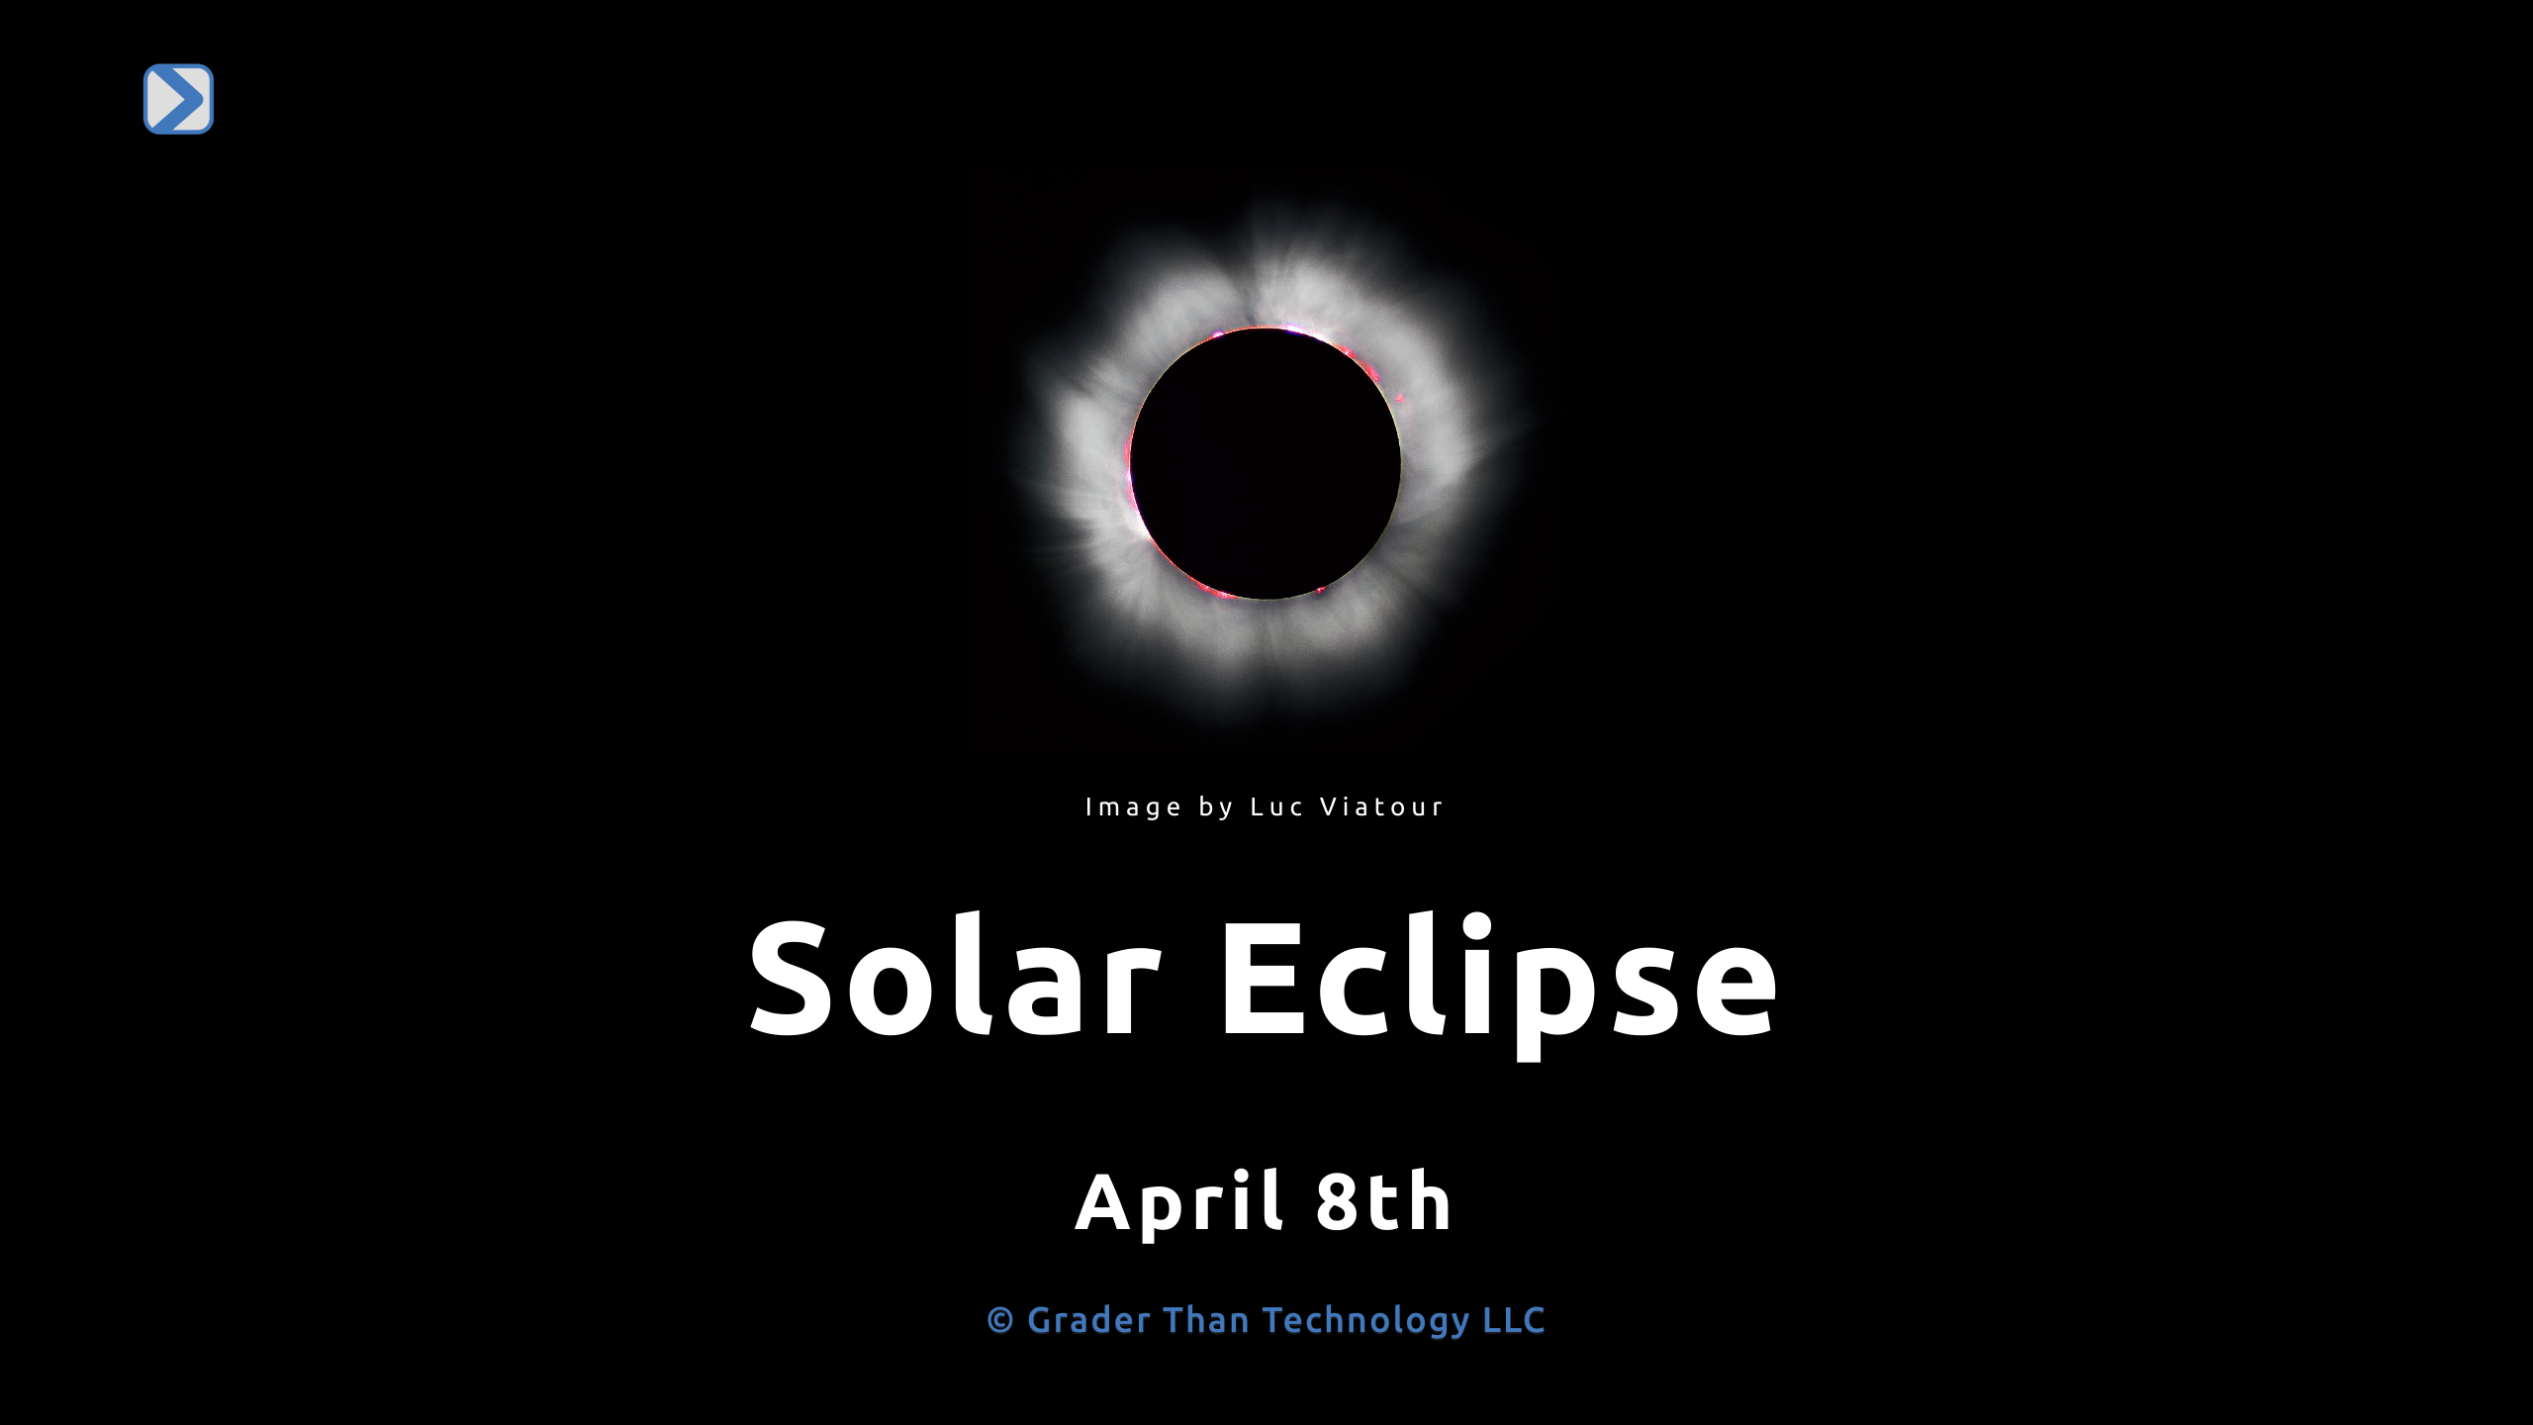
Notes:
- A solar eclipse happens when the Moon moves between the Sun and Earth, creating a shadow on Earth. - Solar eclipses are rare. The last total eclipse in America was in 2017. - At least two solar eclipses occur each year somewhere on Earth. - Total eclipses happen only during a new moon, about once every 1-2 years.

Slide 2
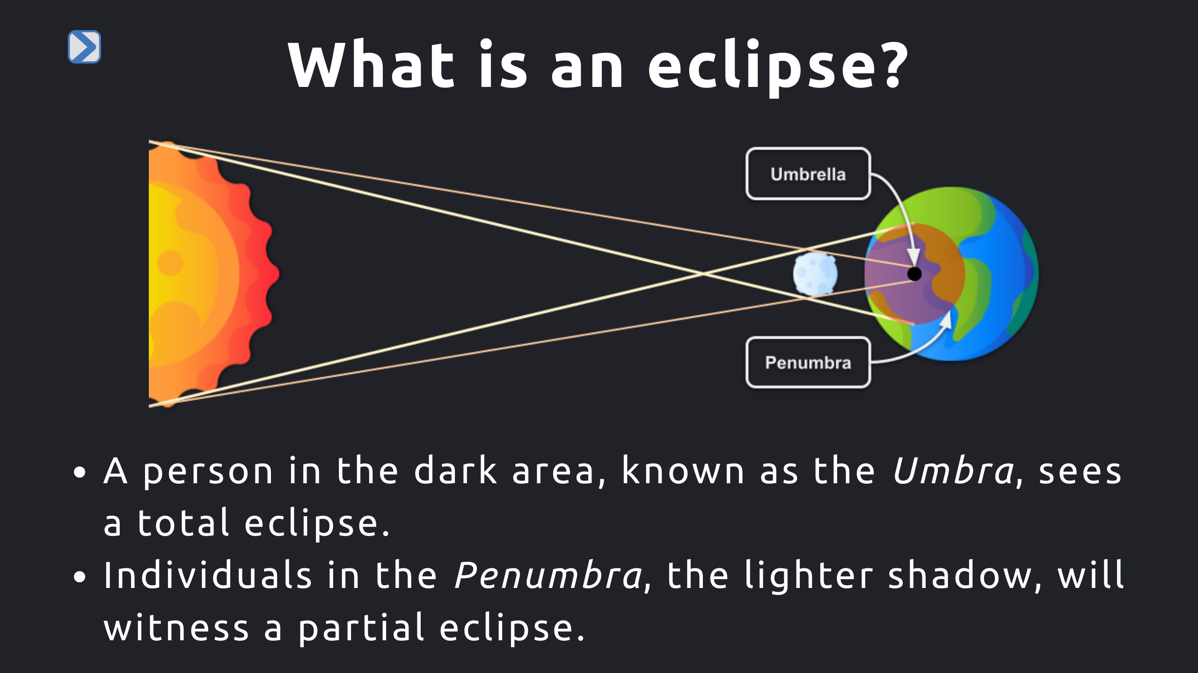
Notes:
- A solar eclipse occurs when the Moon passes between the Sun and the Earth, casting its shadow on Earth. - This event happens during the new moon phase, when the Moon's dark side faces Earth. - Total solar eclipses, where the Sun and Moon appear the same size in the sky, are a special kind of eclipse. - Typically, Earth experiences two solar eclipses each year, but total eclipses are rarer. - As the Moon slowly drifts away from Earth, total solar eclipses will become even rarer and eventually cease.

Slide 3
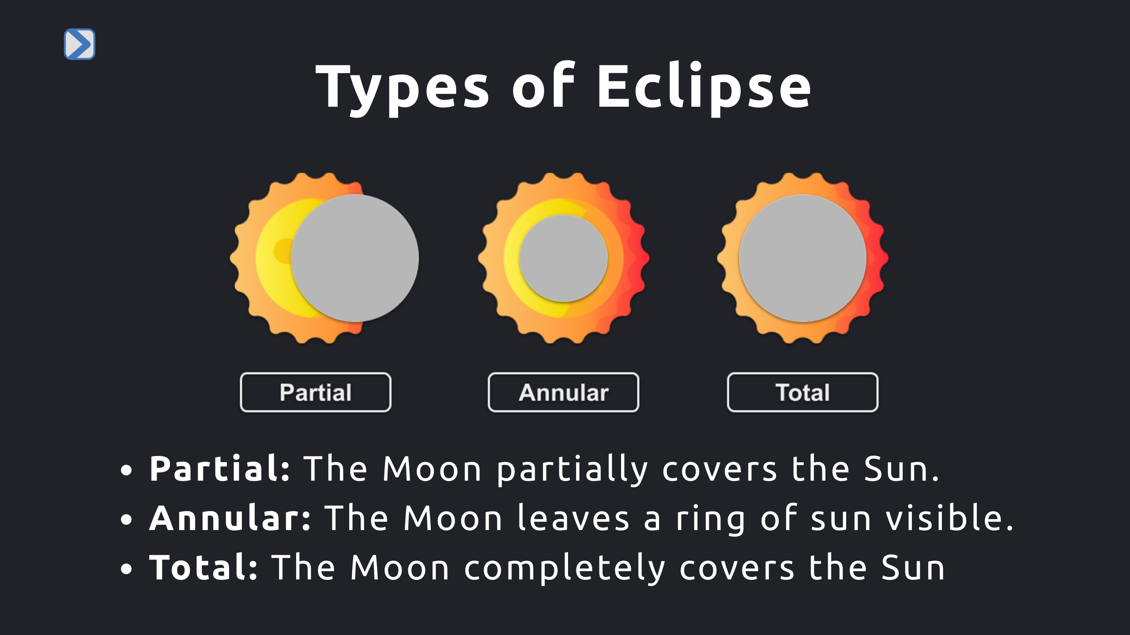
Notes:
- This slide showcases the three main types of solar eclipses: partial, annular, and total. - In a partial eclipse, the Moon only covers a part of the Sun, leading to a partial shadow on Earth. - An annular eclipse occurs when the Moon is directly in front of the Sun but doesn't completely cover it, creating a "ring of fire" appearance. - Annular eclipse happens when the moon's orbit is further from the earth so the moon appears smaller from perspective of an observe on earth. - During a total eclipse, the Moon fully covers the Sun, plunging a specific area on Earth into darkness.

Slide 4
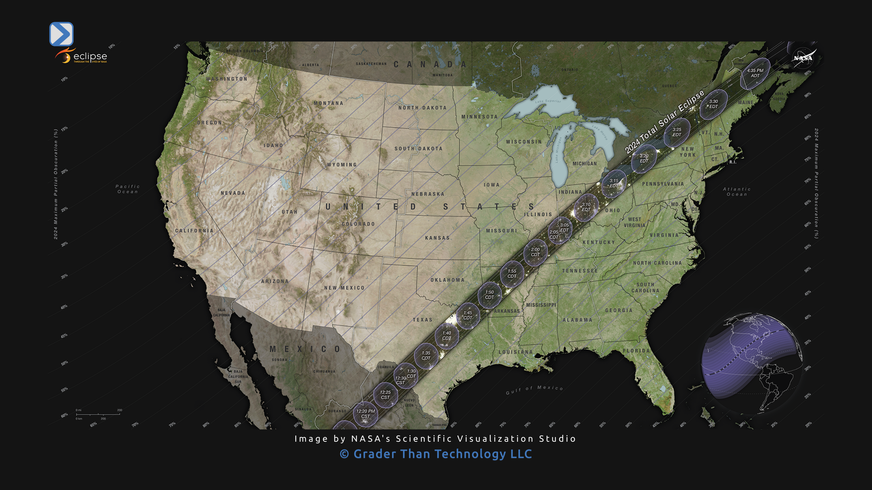
Notes:
- The image shows the path of the eclipse across America on April 8th, 2024. - The dark, thicker line represents the umbra, where viewers will see a total eclipse. - The thinner lines illustrate the penumbra, indicating areas that will experience a partial eclipse.

